Slide 1

MILESTONE 3 PRESENTATION
Submitted to: Dr. Tim Maciag
Email: Tim.Maciag@uregina.ca
(36-337-2407)
Submitted by: Braintrust Group
School/Discipline: University of Regina/SSE
Date: June 13, 2018

Slide 2
AGENDA
Objectives of Study
Research Methodology Used
Analysis Technique
Sampling
Data collection Method
Analysis and Interpretation
Findings and Recommendations
Limitations of the study
Conclusion

Slide 3
OBJECTIVES OF STUDY
To analyze usability and related functionality of Braintrust’s eIDEAS application from both a quantitative and qualitative perspective.

Slide 4
RESEARCH METHODOLOGY USED
Sampling Design: The sampling design was preselected for the Braintrust’s research team by the product manager (JaniceWilby).
Population: eHealth Employees’
Sources of Data:
Primary sources: The primary data was collected through questionnaires. Primary data consists of original information gathered from sample size of 6 respondents from eHealth.
Secondary sources: Secondary data collected from UR Courses;
(Link: https://urcourses.uregina.ca/login/index.php)

Slide 5
ANALYSIS TECHNIQUE
Quantitative analysis is performed using the data collected at each outlet to estimate Braintrust’s eIDEAS application;
Tools Utilized (Usability Questionnaire)
Percentage Analysis and Pie Chart

Slide 6
SAMPLING
Sample Unit: Employees who may use the eIDEAS application at eHealth.
Sample size: 6 respondents (Age ranging between 18– 46 years or above).
Method: Questionnaire
Data analysis method: Statistical method.
Area of survey: eHealth, Regina (Government of Saskatchewan)
Timing of survey: 8:30 am to 10:45am.

Slide 7
FIELD WORK- DATA COLLECTION METHOD
Questionnaire was prepared by keeping the research objectives in mind.
Accurate information was obtained by conducting direct interviews.

Slide 8
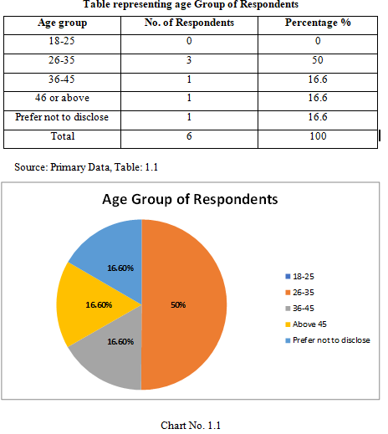
ANALYSIS AND INTERPRETATION
1.6 ANALYSIS AND INTERPRETATION
1.6.1 Age group of Respondents:
Result: This graph depicts
most of the respondents
(i.e. 50%) fall in the age group
of 26-35

Slide 9
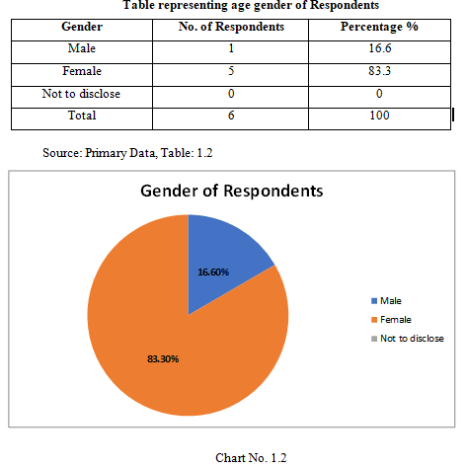
Cont.
1.6.2 Gender of Respondents: The gender of the respondents was divided into 3 groups: male, female, and I would like not to disclose.
Result: 16.6% respondents were
male, 83.3% were female.
This graph itself is showing more
percentage of females rather
than males.

Slide 10
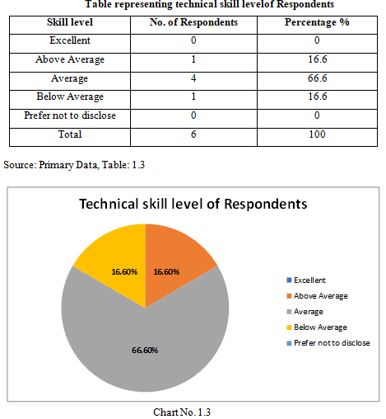
Cont.
1.6.3 Technical Skill level of Respondents: The level of technical skills of respondents (6) were divided
into a specific scale. The scale
was: Excellent, Above Average,
Average, Below Average,
Prefer not to disclose.
Result: Most of the respondents
(66.6%) rated themselves as
average with respect to
technical skill level.

Slide 11
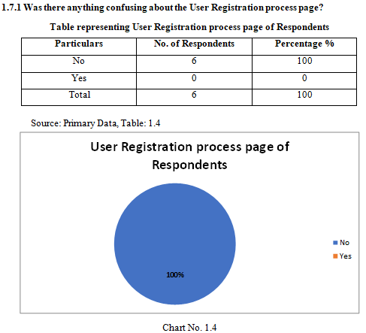
Create User Account
1.7 Create a User Account (Registration)
1.7.1 Was there anything confusing about the User Registration process page?
Result:
The respondents unanimously
agreed that there was nothing
confusing about the User
Registration process.

Slide 12
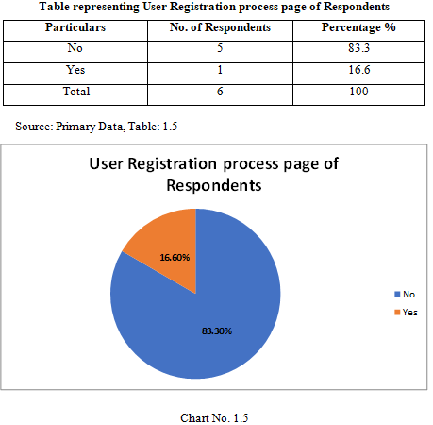
Create User Account Cont.
1.7.2: Was there anything missing from the Registration screen that you were expecting?
Result:
Only one response indicated to
add something to the
Registration screen.

Slide 13
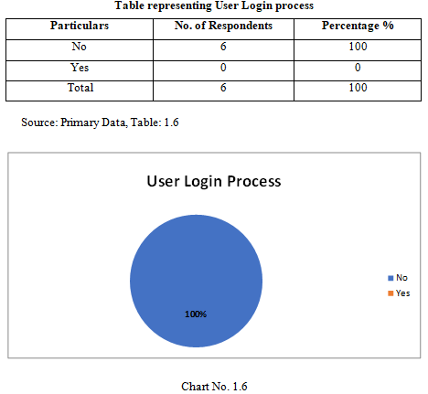
Login to User Account
1.8 Login to User Account
1.8.1 Was there anything confusing about the Login process?
Result:
As is evident from the chart that
100% respondents are satisfied
with “Login to User Account”
page.

Slide 14
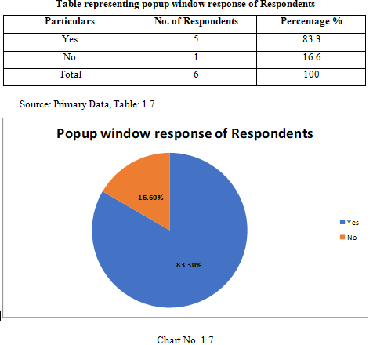
eIDEAS Home Page
1.9 eIDEAS Homepage
1.9.1 Do you think the ‘About eIDEAS’ popup window will be valuable for a new user?
Result:
The chart shows that 83.3% of
Respondents indicated that
the ‘About eIDEAS’ popup
window would be valuable
for a new user.

Slide 15
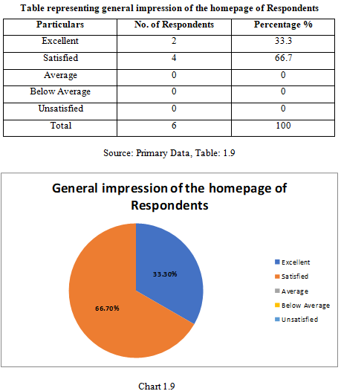
eIDEAS Home Page Cont.
1.9.3 What is your general impression of the Homepage?
Result:
Home page was well received by
respondents with all respondents
rating satisfied or excellent.

Slide 16
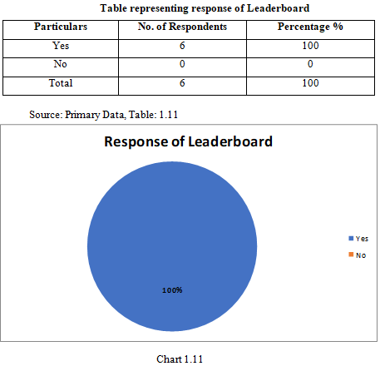
Leaderboard Page
1.10 Leaderboard
1.10.1 Was the Leaderboard page easy to navigate?
Result:
100% result shows leadership
page has all features for easy
navigation. It is a good sign for
Braintrust’s “Leaderboard” page.

Slide 17
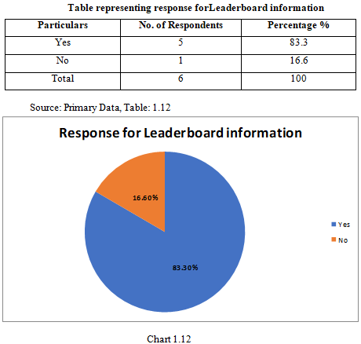
Leaderboard Page Cont.
1.10.2 Do you think the Leaderboard page contains valuable information?
Result:
83.3% result shows leaderboard
page contains valuable
Information.

Slide 18
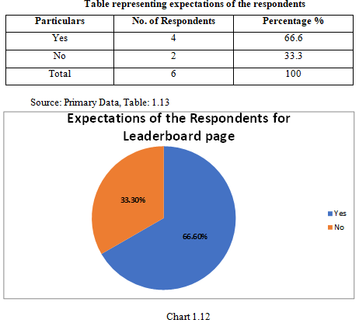
Leaderboard Page Cont.
1.10.3 Was there something missing from the Leaderboard page that you were expecting?
Result:
66.6% result shows Leaderboard
page needs to be improved.

Slide 19
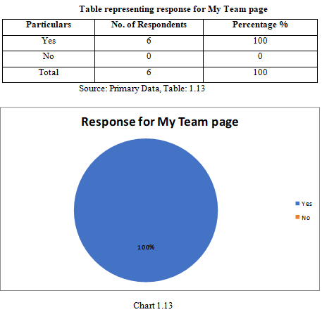
My Team
1.11 My Team
1.11.1 Was it apparent or Obvious that clicking on an idea expansion for displaying more information?
Result:
All respondents agreed that
clicking on an idea expansion
Was obvious or easy.

Slide 20
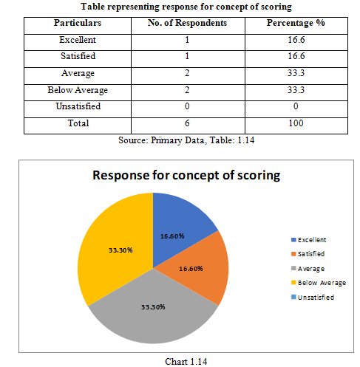
My Team Cont.
1.11.2 How satisfied are you with the concept of scoring (e.g. 4.8 score) an idea?
Result:
Above chart shows the
Complicated results. Need to
focus more on scoring an idea.
Yet the overall result is still
positive.

Slide 21
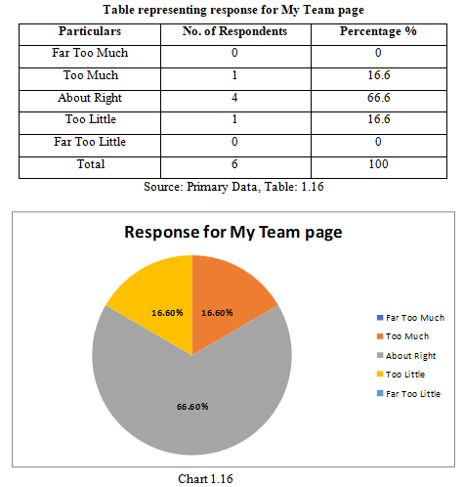
My Team Cont.
1.11.4 How did you feel about the amount of information presented for each idea?
Result:
66.6% result shows information
presented for each idea was
about right.

Slide 22
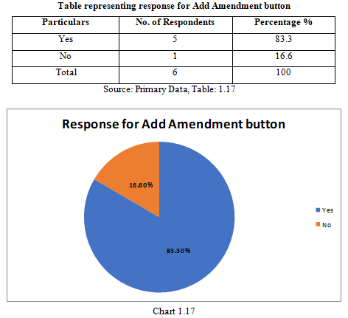
My Team Cont.
1.11.5 Did you like the idea of the ‘Add Amendment’ button?
Result:
83.3% result shows Add
Amendments button is a great
idea.

Slide 23
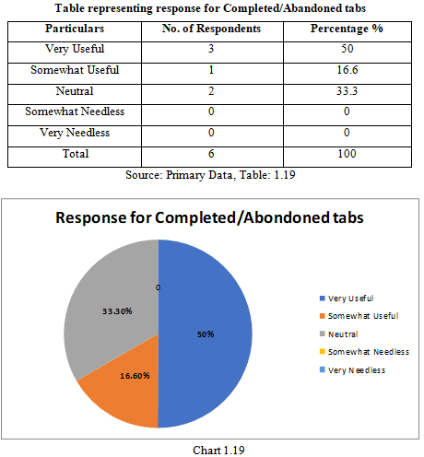
My Team Cont.
1.11.7 How useful do you think the Completed/Abandoned tabs are in the Current Team Ideas page?
Result:
The Completed/Abandoned tabs
in the Current Team Ideas page
were very useful.

Slide 24
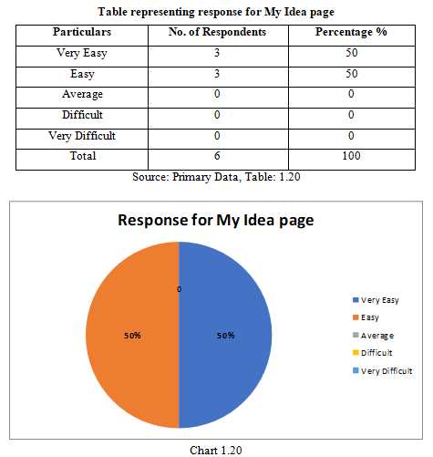
My Ideas Page
1.12 My Ideas
1.12.1 How easy was it to add your idea?
Result:
Mostly all the users are satisfied
with usability of My Idea page.

Slide 25
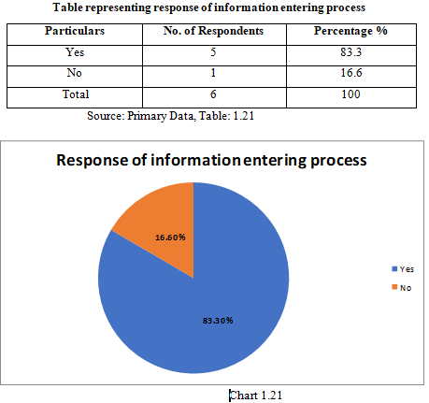
My Ideas Page Cont.
1.12.2 Was the information entering process for creating an idea intuitive/natural?
Result:
83.3% result shows
information entering for
idea creation was intuitive.

Slide 26
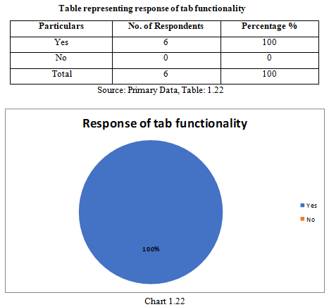
My Ideas Page Cont.
1.12.3 Was the content of each tab properly expressed by its title?
Result:
100% result shows each tab
properly expressed.

Slide 27
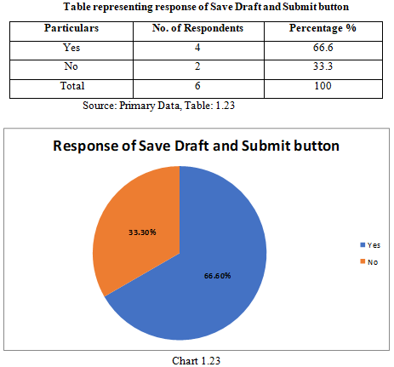
My Idea Page Cont.
1.12.4 Did the ‘Save Draft’ and ‘Submit’ buttons function as you expected?
Result:
33.3% respondents were
expecting a pop-up message
or mouse over information.

Slide 28
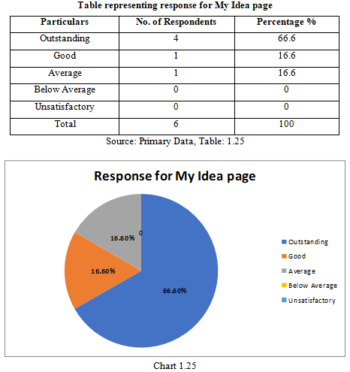
Overall Application Rating
1.13 Overall Rating of the Application
Result:
Chart shows that mostly all
respondents were satisfied with
the usability of the application.

Slide 29
FINDINGSAND RECOMMENDATIONS
Mostly all respondents were satisfied with the usability of the application.
The respondents unanimously agreed that there was nothing confusing about the User Registration process.
Home page was well received by respondents with all respondents rating satisfied or excellent.
100% result shows leadership page has all features for easy navigation. It is a good sign for Braintrust’s “Leaderboard” page.
All respondents agreed that clicking on an idea expansion was obvious or easy.
100% result shows expand/collapse is a great idea.
100% result shows each tab properly expressed.
Mostly all the users are satisfied with usability of My Idea page. They felt it was easy to add an idea.
Only one response indicated to add something to the Registration screen. According to the comments section, the respondent wanted an option to upload an image or picture.
66.6% result shows Leaderboard page needs to be improved. Various suggestions include: weighting for team size, display more information about points, visual data charts; and why concept of points?

Slide 30
LIMITATIONS OF THE STUDY
Small Sample Size:To complete any study, one should have a diversified sample, since our time and resources did not allow us to increase our sample size, so research can be biased also.
Time Constraints:Period of 45 minutes was not enough to collect all the data.
Human Errors: “to err is human”, as Questionnaires have been filled by human beings, so they are prone to error knowingly or unknowingly.

Slide 31
CONCLUSION
Overall, the application was well received as indicated by the questionnaire results. Certain aspects of the systems may need minor alterations with respect to management, point systems, and user expectations (display and mouse over information).

